Slide 1
Network Programming
K Hari Babu
Department of Computer Science & Information Systems

Slide 2
TCP/IP

Slide 3
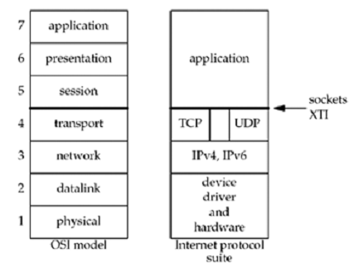
OSI & Internet protocol suite
3

Slide 4
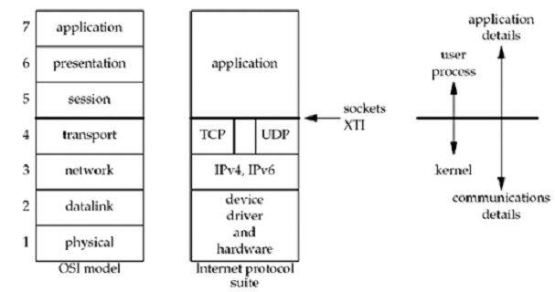
TCP/IP

Slide 5
TCP or UDP
At the internet layer, a destination address identifies a host computer; no further distinction is made regarding which process will receive the datagram
TCP or UDP add a mechanism that distinguishes among destinations within a given host, allowing multiple processes to send and receive datagrams independently

Slide 6
Why process is not the destination for a message?
Processes are created and destroyed dynamically
A process can be repalced with a new process without informing all senders
Identify a destination by the function rather than the process which implements it
A process can handle multiple functions, so there should a way to specify which one sender desires

Slide 7
Protocol Ports
Instead of thinking process as ultimate destination, imagine that each machine contains a set of abstract destination points called protocol ports
Each protocol port is identified by a positive integer
Operating systems provide some mechanism that processes use, to specify a port.

Slide 8
Port Numbers
The port numbers are divided into three ranges by Internet Assigned Numbers Authority
The well-known ports: 0 through 1023. These port numbers are controlled and assigned by the IANA.
The registered ports: 1024 through 49151. These are not controlled by the IANA, but the IANA registers and lists the uses of these ports as a convenience to the community.
The dynamic or private ports, 49152 through 65535. The IANA says nothing about these ports. These are what we call ephemeral ports. (49152 is three-fourths of 65536.)

Slide 9
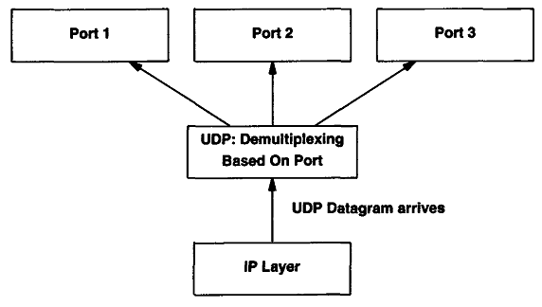
Ports

Slide 10
UDP (User Datagram Protocol)
UDP provides an unreliable connectionless delivery service
UDP uses IP to deliver datagrams to the right host.
UDP uses ports to provide communication services to individual processes.

Slide 11
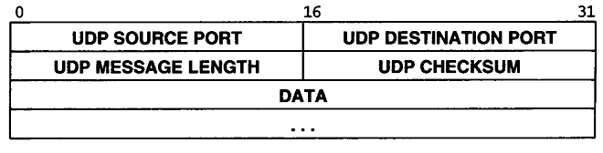
UDP header
Header size is 8 bytes
Lack of reliability:
checksum detects an error
the datagram is dropped in the network
If we want to be certain that a datagram reaches its destination, we can build lots of features into our application: acknowledgments from the other end, timeouts, retransmissions, and the like.

Slide 12
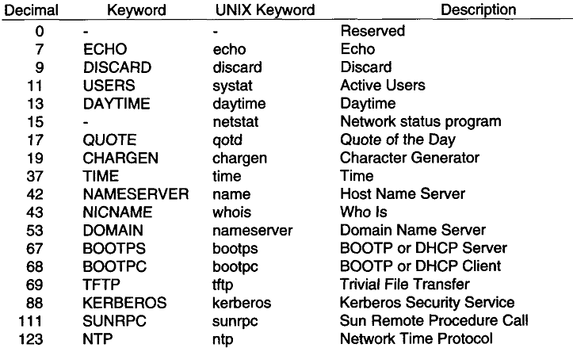
Some standard UDP based services and their ports

Slide 13
TCP Transmission Control Protocol
TCP provides connections between clients and servers.
TCP uses the connection, not the protocol port, as its fundamental abstraction.
Connections are identified by a pair of endpoints.
Endpoint means (ip, port)
TCP provides:
Connection-oriented
Reliable
Full-duplex
Byte-Stream

Slide 14
Connection-Oriented
Connection oriented means that a virtual connection is established before any user data is transferred.
A TCP client establishes a connection with a given server, exchanges data with that server across the connection, and then terminates the connection.
If the connection cannot be established - the user program is notified.
If the connection is ever interrupted - the user program(s) is notified.

Slide 15
TCP Ports
Interprocess communication via TCP is achieved with the use of ports (just like UDP).
UDP ports have no relation to TCP ports (different name spaces).

Slide 16
TCP Segments
TCP views the data stream as a sequence of bytes that it divides into segments for transmission. Segments carry varying sizes of data.
The chunk of data that TCP asks IP to deliver is called a TCP segment.
Each segment contains:
data bytes from the byte stream
control information that identifies the data bytes

Slide 17
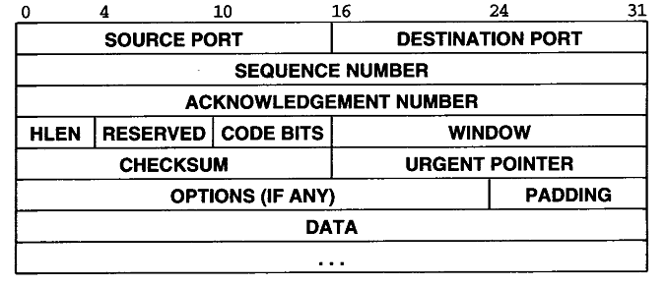
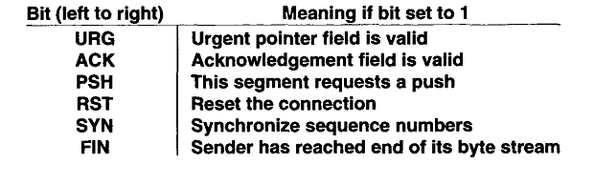
TCP Segment Format

Slide 18
TCP Segments
Segments are exchanged to establish connections, transfer data, send acknowledgements, advertise window sizes, and close connections.
Because TCP uses piggybacking, acknowledgement can be sent along with data
TCP advertises how much data it is willing to accept every time it sends segment by specifying its buffer size in the WINDOW field

Slide 19
TCP Connection Establishment
Three-way handshake
It accomplishes two important functions.
It guarantees that both sides are ready to transfer data (and that they know they are both ready)
it allows both sides to agree on initial sequence numbers.
Sequence numbers are sent and acknowledged during the handshake. Each machine must choose an initial sequence number at random that it will use to identify bytes in the stream it is sending.

Slide 20
TCP Connection Establishment
When a client requests a connection, it sends a “SYN” segment (a special TCP segment) to the server port.
SYN stands for synchronize. The SYN message includes the client’s ISN.
ISN is Initial Sequence Number.
Every TCP segment includes a Sequence Number that refers to the first byte of data included in the segment.
Every TCP segment includes a Request Number (Acknowledgement Number) that indicates the byte number of the next data that is expected to be received.
All bytes up through this number have already been received.

Slide 21
TCP Connection Establishment
A server accepts a connection.
Must be looking for new connections!
A client requests a connection.
Must know where the server is!
A client starts by sending a SYN segment with the following information:
Client’s ISN (generated pseudo-randomly)
Maximum Receive Window for client.
Optionally (but usually) MSS (largest datagram accepted).
No payload! (Only TCP headers)
When a waiting server sees a new connection request, the server sends back a SYN segment with:
Server’s ISN (generated pseudo-randomly)
Request Number is Client ISN+1
Maximum Receive Window for server.
Optionally (but usually) MSS
No payload! (Only TCP headers)

Slide 22
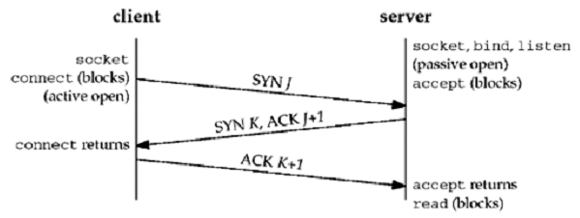
TCP Connection Establishment

Slide 23
Connection Termination
The TCP layer can send a RST segment that terminates a connection if something is wrong.
Usually the application tells TCP to terminate the connection gracefully with a FIN segment.
Either end of the connection can initiate termination.
A FIN is sent, which means the application is done sending data.
The FIN is ACK’d.
The other end must now send a FIN.
That FIN must be ACK’d.

Slide 24
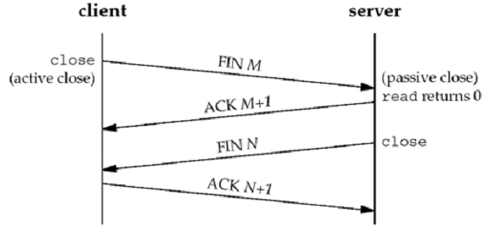
Connection Termination

Slide 25
TCP Connection State Diagram
There are 11 different states defined for a connection
based on the current state and the segment received in that state.
One reason for showing the state transition diagram is to show the 11 TCP states with their names. These states are displayed by netstat, which is a useful tool when debugging client/server applications

Slide 26
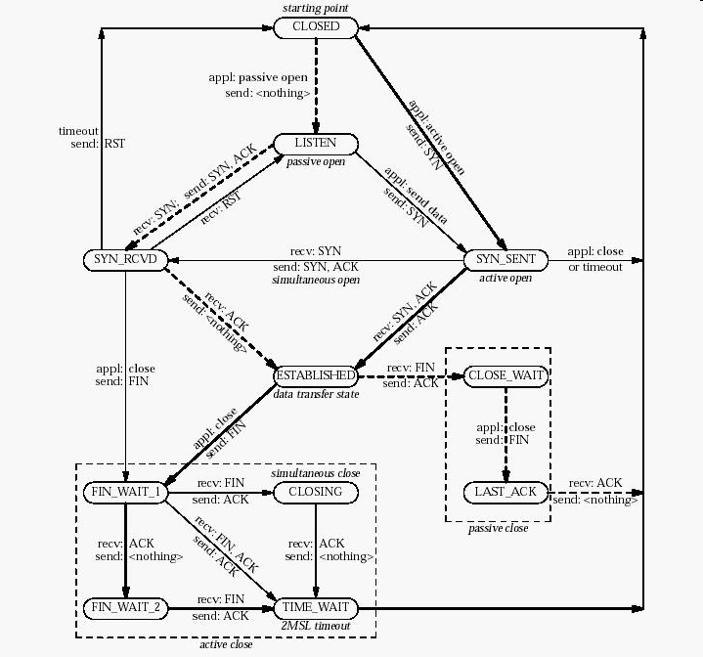

Slide 27
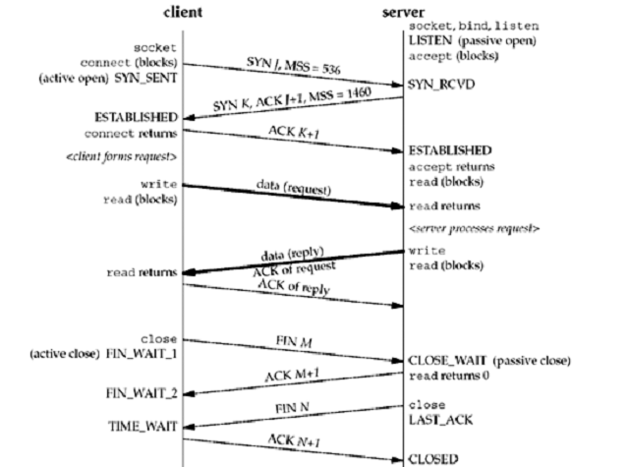

Slide 28
What is the purpose of TIME_WAIT?
Once a TCP connection has been terminated (the last ACK sent) there is some unfinished business:
What if the ACK is lost? The last FIN will be resent and it must be ACK’d.
What if there are lost or duplicated segments that finally reach the incarnation of the previous connection after a long delay?
The MSL is the maximum amount of time that any given IP datagram can live in a network

Slide 29
Outline
Sockets
TCP Client Server

Slide 30
Sockets

Slide 31
OSI & Internet protocol suite
31

Slide 32
TCP/IP & Sockets API
TCP/IP does not include an API definition.
There are a variety of APIs for use with TCP/IP:
Sockets
TLI, XTI
Winsock
MacTCP
API should have the following functionalities
Specify local and remote communication endpoints
Initiate a connection
Wait for incoming connection
Send and receive data
Terminate a connection gracefully
Error handling

Slide 33
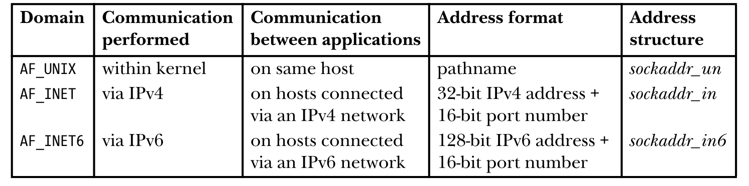
Berkeley Sockets API
First appeared in 42. BSD in 1983.
Supported on every UNIX variant.
WinSock API also follows socket API.
Generic API:
support for multiple communication domains which differ in addressing methods.
Uses existing I/O programming interface as much as possible.
Socket API is similar to file I/O

Slide 34
Socket
A socket is an abstract representation of a communication endpoint.
Sockets work with Unix I/O services just like files, pipes & FIFOs.
read(), write() and close() sys calls work on sockets also
Sockets have special needs over files:
establishing a connection.
specifying communication endpoint addresses.

Slide 35
Socket Types
Two types of sockets
Stream Sockets
Reliable
Bidirectional
Byte-stream
Connection-oriented
Stream sockets operate in connected pairs. (local end point, remote end point)
Internet Domain: TCP Socket
Datagram Sockets
Message boundaries are preserved.
No reliability support: out of order, duplicates, or lost datagrams
Connectionless socket: no need to be connected to another socket.
Internet Domain: UDP Socket

Slide 36
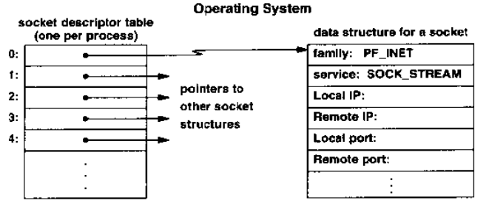
Socket Descriptor Data Structure

Slide 37
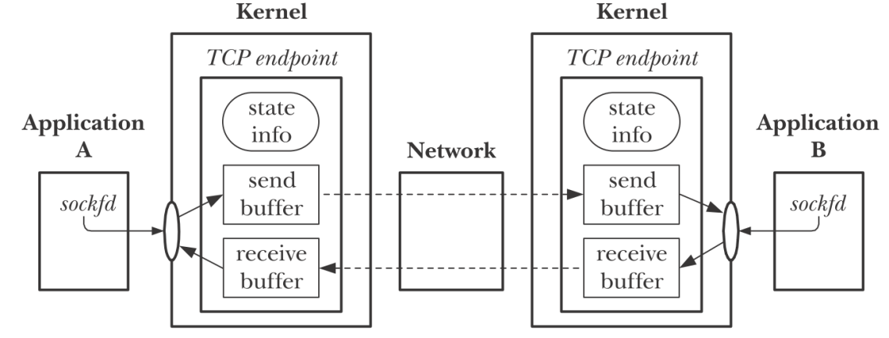
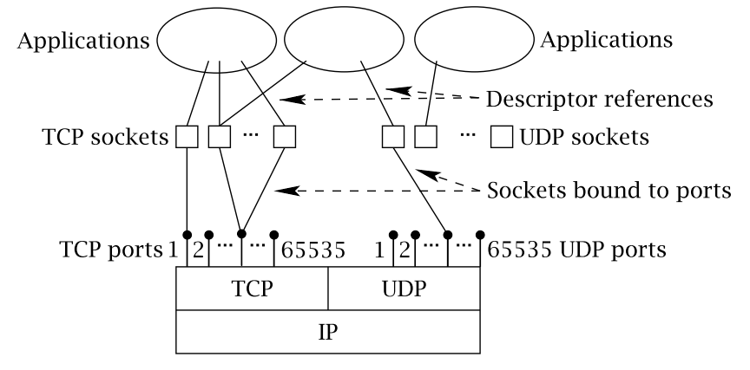
Internet Domain & Sockets
Endpoint is identified by ip address and port number.
A socket needs to be bound to endpoints local and remote.

Slide 38
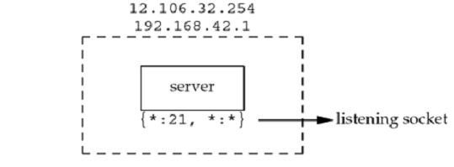
Socket Pair
The socket pair for a TCP connection is the four-tuple that defines the two endpoints of the connection:
the local IP address, local port, foreign IP address, and foreign port.
A socket pair uniquely identifies every TCP connection on a network.
We can extend the concept of a socket pair to UDP, even though UDP is connectionless.
TCP connection for a ftp server:
Server has two IP interfaces. * indicates any ip address/any port.

Slide 39
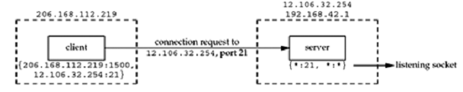
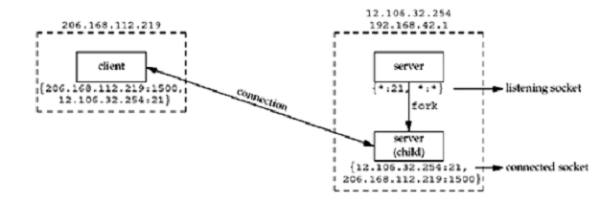
TCP Connection
A client 206.168.112.219 connects to 12.106.32.254 at port 21.
Server creates a child to handle new cleint.
See the new TCP connection pair on server.

Slide 40
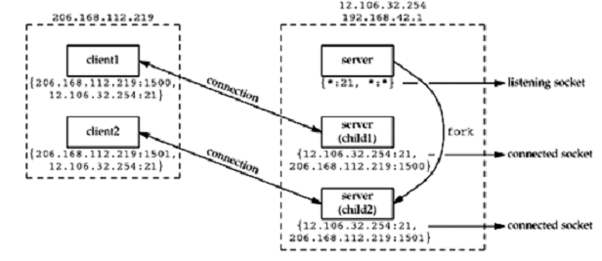
TCP Connection
Client opens one more connection to the same server. What makes it a different TCP connection?

Slide 41
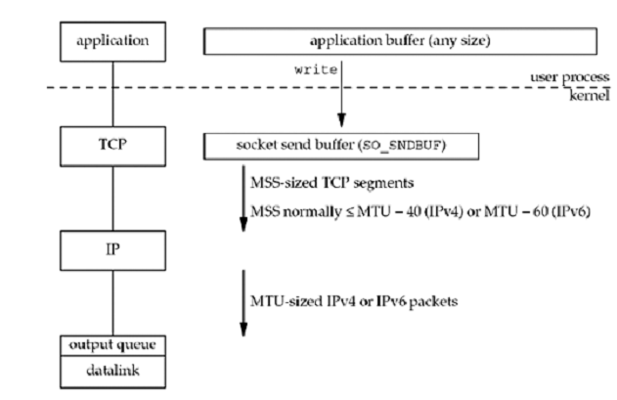
Writing to TCP Socket

Slide 42
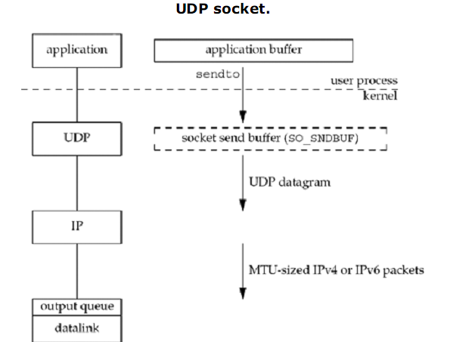
Writing to UDP Socket

Slide 43

Creating a Socket
Domain argument specifies the communication domain.
Type argument specifies the socket type
Protocol is usually 0. Its value is automatically from first two arguments.
But for raw sockets, protocol value can be specified.
The socket() system call returns a socket descriptor (small integer) or -1 on error.
socket() allocates resources needed for a communication endpoint - but it does not deal with endpoint addressing.

Slide 44

Specifying an Endpoint Address
Remember that the sockets API is generic.
There must be a generic way to specify endpoint addresses.
Internet Domain requires an IP address and a port number for each endpoint address.
Other domains (families) may use other schemes.
Data types for specifying address structure

Slide 45
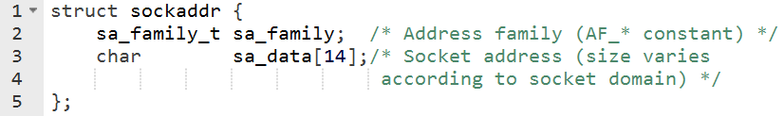
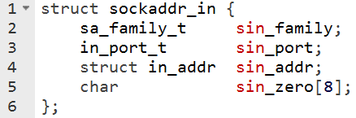

Generic Socket Address Structure
General socket address structure acts as template.
All sys calls take this as the input.
For IPv4 domain, socket address structure is

Slide 46

Specifying End Point Address
Bind call binds an address to a socket
Bind is used to bind the socket to a local end point.
addr is the pointer to an address structure that contains the endpoint address.
process specifies |  | result
IP address | port
Wildcard | 0 | kernel chooses IP addr and port
Wild card | nonzero | kernel chooses IP, process specifies port
local IP addr | 0 | process specifies IP, kernel chooses port
local IP addr | nonzero | process specifies IP and port
Wildcard specified as INADDR_ANY

Slide 47
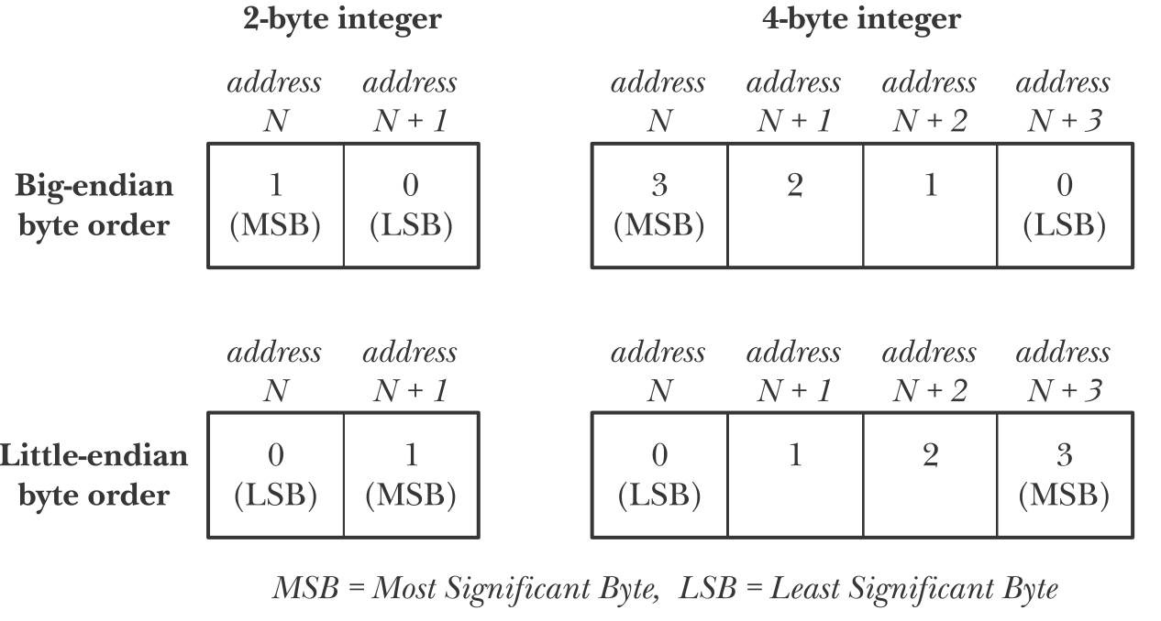
Byte Order
Different hardware architectures in the network. Passing integers across the network needs to be in standard format: Network Byte Order (NBO): bigendian byte order.

Slide 48
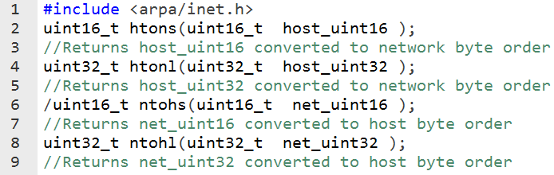
Network Byte Order Functions
‘h’ : host byte order ‘n’ : network byte order
‘s’ : short (16bit) ‘l’ : long (32bit)

Slide 49
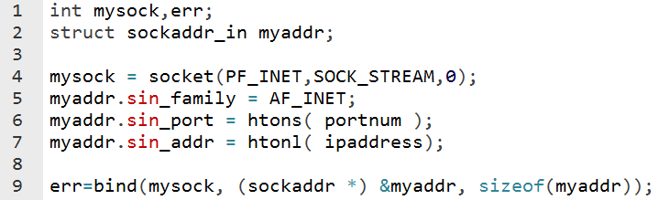
bind() Example
Note the usage of byte conversion.
Nit the casting internet domain address to generic address structure.
There are a number of uses for bind():
Server would like to bind to a well known address (port number).
Client can bind to a specific port.
Client can ask the O.S. to assign any available port number.

Slide 50
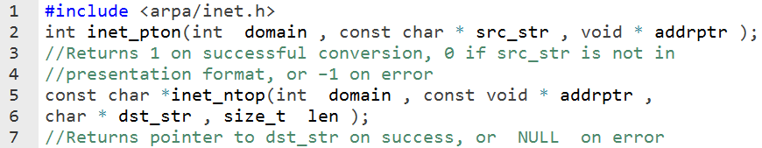
IPv4 Address Conversion
The inet_pton() and inet_ntop() functions allow conversion of both IPv4 and IPv6 addresses between binary form and dotted-decimal or hex-string notation.
The p in the names of these functions stands for “presentation,” and the n stands for “network.” The presentation form is a human-readable string.

Slide 51
Client Server Programming

Slide 52
Active & Passive Sockets
By default, a socket that has been created using socket() is active.
An active socket can be used in a connect() call to establish a connection to a passive socket.
This is referred to as performing an active open.
A passive socket (also called a listening socket) is one that has been marked to allow incoming connections by calling listen().
Accepting an incoming connection is referred to as performing a passive open.
client:
which does active socket open
Server:
which does passive socket open.

Slide 53
TCP Client Server
_{Server}
Diagram Source: sjsu.edu
_{socket()}
_{bind()}
_{“well-known”}
_{port}
_{listen()}
_{Client}
_{accept()}
_{socket()}
_{(Block until connection)}
_{“Handshake”}
_{connect()}
_{Data (request)}
_{read()}
_{write()}
_{Data (reply)}
_{write()}
_{read()}
_{End-of-File}
_{close()}
_{read()}
_{close()}

Slide 54
TCP Client
Diagram Source: sjsu.edu
PF_INET PF_INET6 PF_UNIX PF_X25
STREAM DGRAM RAW
0, used by RAW socket
sd = socket (family, type, protocol);
family
port
ephemeral port ip addr (routing)
three way handshaking
addr
sd = connect (sd, server_addr, addr_len);
write (sd, *buff, mbytes);
Server PORT# IP-ADDR
CONNECT actions
1. socket is valid 2. fill remote endpoint addr/port 3. choose local endpoint add/port 4. initiate 3-way handshaking
read (sd, *buff, mbytes);
disconnect sequence
close (sd);

Slide 55
TCP Server
Diagram Source: sjsu.edu
LISTEN SOCKET
sd = socket (family, type, protocol);
family
port
well-known port # INADDR_ANY
addr
bind port #
bind (sd, *server_addr, len);
listen (sd, backlog);
1. Turn sd from active to passive
2. Queue length
family
CONNECT SOCKET
three way handshaking
ssd = accept (sd, *cliaddr, *len);
port
addr
read (ssd, *buff, mbytes);
closes socket for R/W non-blocking attempts to send unsent data socket option SO_LINGER block until data sent
write (ssd, *buff, mbytes);
disconnect sequence
close (ssd);

Slide 56

connect() - connect to server
The connect() system call connects the active socket referred to by the file descriptor sockfd to the listening socket whose address is specified by addr and addrlen.
sockfd is socket descriptor from socket()
servaddr is a pointer to a structure with:
port number and IP address
must be specified (unlike bind())
addrlen is length of structure
client doesn’t need bind()
OS will pick ephemeral port
returns socket descriptor if ok, -1 on error

Slide 57
connect() - connect to server
Errors
If the server’s TCP response to client TCP’s SYN segment is RST, then there is no process is waiting for incoming connections.
Hard error
Three conditions that generate RST are
when a SYN arrives for a port that has no listening server
when TCP wants to abort an existing connection
when TCP receives a segment for a connection that does not exist
If client’s SYN request elicits ICMP “destination unreachable” message, kernal saves the message but keeps on sending the SYN segment.
Soft error

Slide 58

listen() - change socket state to passive
The listen() system call marks the stream socket referred to by the file descriptor sockfd as passive.
The socket will subsequently be used to accept connections from other (active) sockets.
sockfd is socket descriptor from socket()
backlog is maximum number of connections that the server should queue for this socket
historically 5
rarely above 15 on a even moderate Web server!

Slide 59
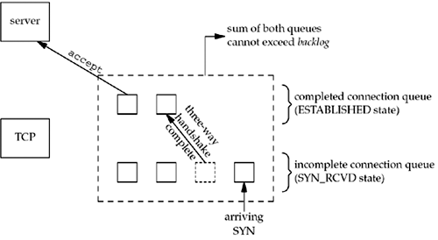
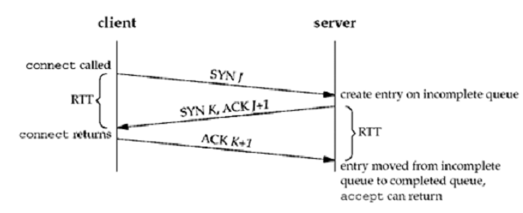
listen()

Slide 60
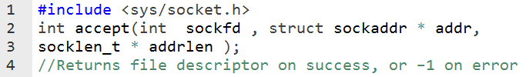
accept() - return next completed connection
The accept() system call accepts an incoming connection on the listening stream socket referred to by the file descriptor sockfd.
If there are no pending connections when accept() is called, the call blocks until a connection request arrives.
sockfd is socket descriptor from socket()
cliaddr and addrlen return protocol address from client
returns brand new descriptor, created by OS
if used with fork(), can create concurrent server

Slide 61
close() - close socket fd
sockfd is socket descriptor from socket()
closes socket for reading/writing
returns (doesn’t block)
attempts to send any unsent data
socket option SO_LINGER
block until data sent
or discard any remaining data
Returns -1 if error

Slide 62
Descriptor Reference Counts
For every socket a reference count is maintained, as to how many processes are accessing that socket
When close() is called on socket descriptor reference count is decreased by 1
When close() is called on socket descriptor, TCP 4 packet termination sequence will be initiated only if the reference count goes to zero.

Slide 63
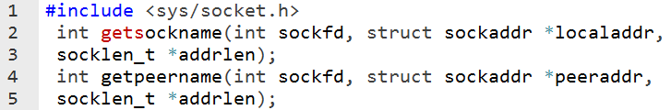
getsockname() and getpeername() Functions
getsockname return the local endpoint address associated with a socket
getpeername return the foreign protocol address associated with a socket

Slide 64
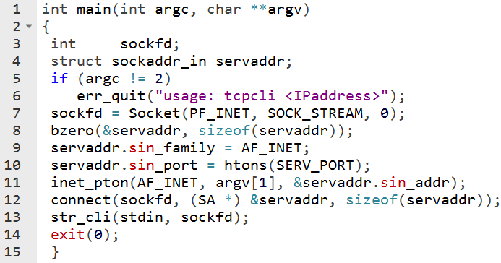
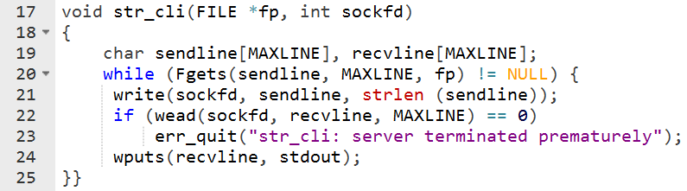
TCP Echo Client
TCP client and server using echo protocol

Slide 65
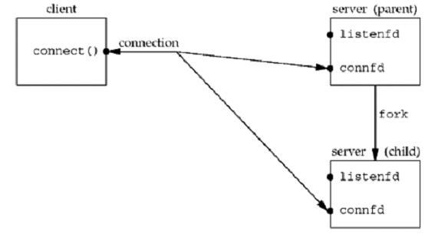
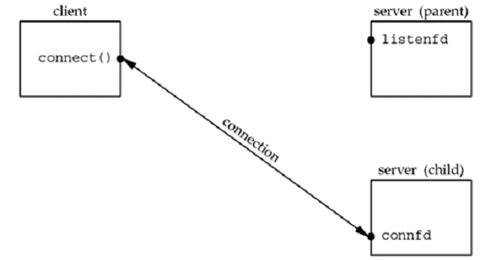
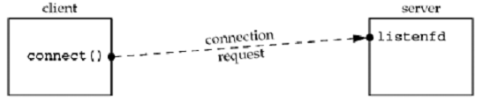
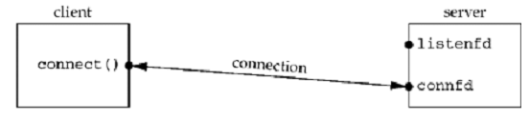
TCP Concurrent Server

Slide 66
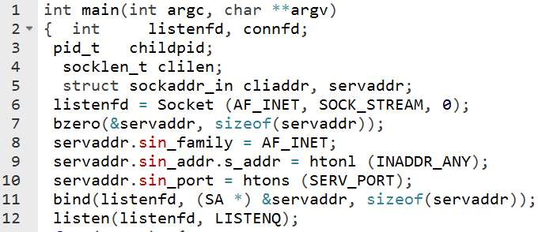
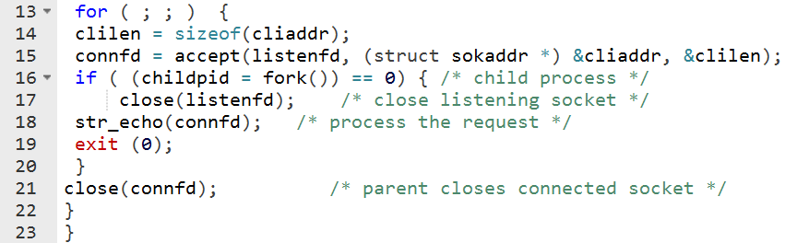
TCP Concurrent Server

Slide 67
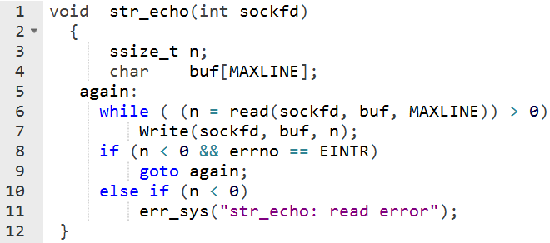
str_echo function

Slide 68
TCP Concurrent Server
Handling zombies
while ( (pid = waitpid(-1, &stat, WNOHANG)) > 0) in SIGCHLD signal handler
Handling interrupted system calls
when writing network programs that catch signals, we must be cognizant of interrupted system calls, and we must handle them
Slow system call is any system call that can block forever

Slide 69
Handling interrupted system calls
for ( ; ; ) {
clilen = sizeof (cliaddr);
if ( (connfd = accept (listenfd, (SA *) &cliaddr, &clilen)) < 0) {
if (errno == EINTR)
continue; /* back to for () */
else
err_sys ("accept error");
}
Another option:
Use sigaction() with SA_RESTART flag.

Slide 70
Termination of Server Process
FIN is sent to client
Client tcp sends ACK to server
What if client application doesn’t take not of it, and sends data to server?

Slide 71
SIGPIPE Signal
When a process writes to a socket that has received an RST, the SIGPIPE signal is sent to the process.
The default action of this signal is to terminate the process, so the process must catch the signal to avoid being involuntarily terminated.

Slide 72
Crashing of Server Host
Nothing is sent to client
Client will try to reach the host, but will get errors such as ETIMEDOUT, EHOSTUNREACH, ENETWORKUNREACH

Slide 73
Crashing and Rebooting of Server Host
When client sends packets, server will respond with RST

Slide 74
Shutdown of Server Host
Init sends SIGTERM to all processes
Then sends SIG KILL to all processes
Fin is sent to the client

Slide 75
Exercise
Write a TCP client and server that fulfills the following requirements.
Server.c:
server should take port number on command-line and listen on that port.
server should create a child to handle a new client.
When a client sends a command such as 'ps', server should execute the command and send the output to the client.
it should take care of zombies.
Client.c:
client takes ip address and port number of the server on command-line.
client sets up a connection to the server.
client takes a command from the user and sends it to the server.
client waits for the reply and prints the reply on the standard output.

Slide 76
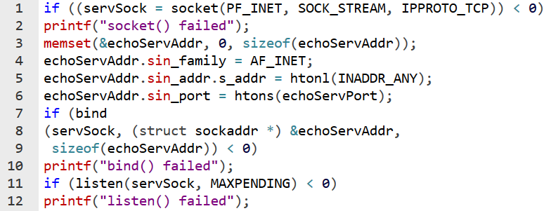

Slide 77
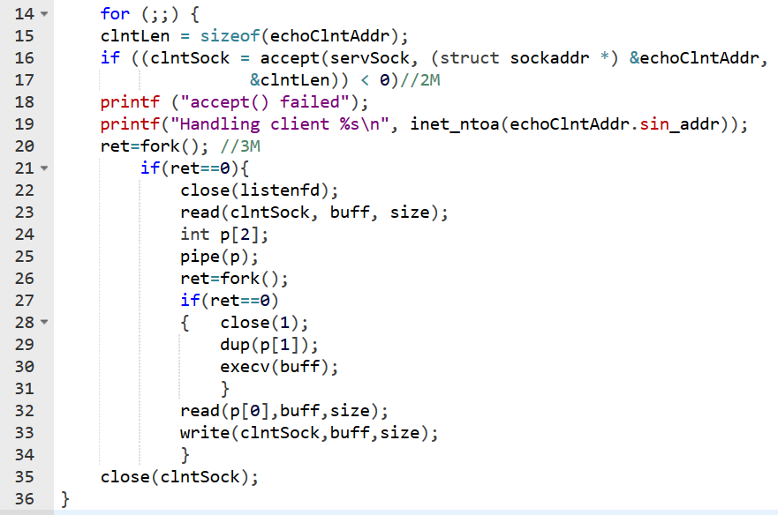

Slide 78
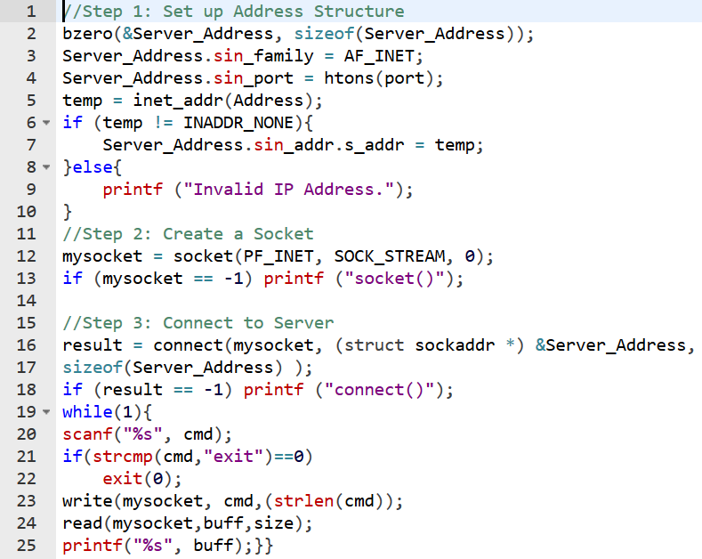

Slide 79
Acknowledgements

Slide 80
Q&A

Slide 81
Thank You

